Slide 1
CSC 236
Tutorial 1 - Daniel Razavi

Slide 2

Welcome to my class!!!
First Time being a TA
My experience when I took this course
Emotional Investment is key to better learning!

Slide 3

Contacting Me
Piazza!!! Best Way To Be Honest
or
daniel DOT razaviazarkhiavi AT mail DOT utoronto DOT ca
Please look at when I accept emails carefully, before sending me one, since I will not reply otherwise.

Slide 4
Accessibility

Slide 5
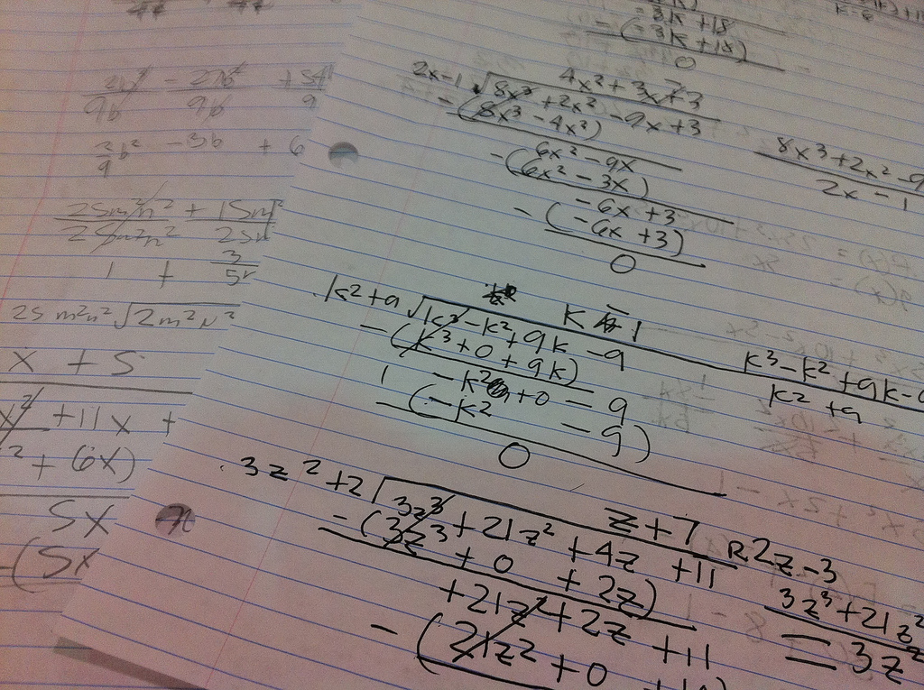
Word Of Advice
Please Prep Before The Tutorial
Tutorial is for Questions Mostly, Less about reteaching
In class problem are the highlight of tutorial sessions.

Slide 6
Any Questions?

Slide 7
Today’s In Class Problem Set

Slide 8
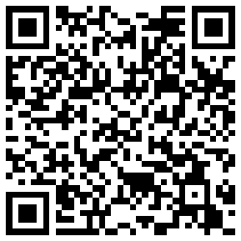

Slide 9
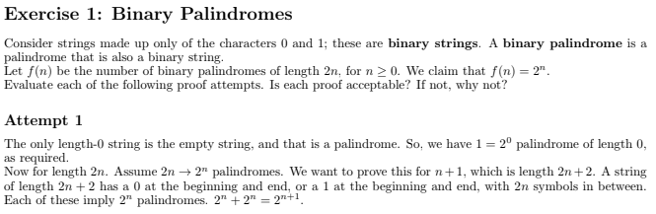

Slide 10
Base Case is Ok But it should really be discussing “binary strings”, not “strings”

Slide 11
The 2n -> 2^n thing is meaningless. What does the right arrow mean? Shouldn’t be mixing symbols.

Slide 12
What’s “this”?

Slide 13
“Imply” is a poor word. The proof is trying to use the I.H. (Induction Hypothesis) but it is unclear by the proof that this is the case.

Slide 14
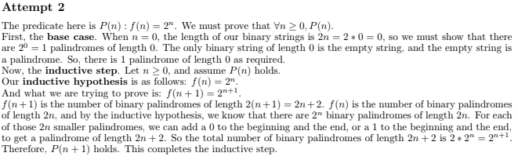

Slide 15
Better then attempt 1, but not explicit enough on the proof. They have the right idea but they failed to mention that by adding either 0 or 1 at the beginning and end of the palindromes with 2n length, the new 2n+2 palindrome that they have attained are unique and that there are no other possible palindromes of length 2n+2. That way we are sure that there are no duplicate palindromes or failed to generate some required palindrome.

Slide 16


Slide 17
Step 1: Base Case

Slide 18
Step 1: Base Case
We know that we can achieve 6c (the absolute minimum value that the questions claims can be reproduced) with two 3c stamps.
That’s base case.

Slide 19
Step 2: Inductive Case

Slide 20
Step 2: Inductive Case
Suppose n is larger or equal to 6, and that we CAN form “n c” using only 3c and 4c stamps.
Now all we have to do is to show that “n+1 c” can be formed from 3c and 4c.
Our Assumption

Slide 21
Step 2: Inductive Case
All we have to do is to go through different cases that “n c” could be made using “3 c” and “4 c”.
And really when it comes to this example, there are basically two cases:
If there exists a “3 c” in the formation of “n c”
If there DOESN’T exist a “3c” in the formation of “n c”

Slide 22
Step 2: Inductive Case
All we have to do is to go through different cases that “n c” could be made using “3 c” and “4 c”.
And really when it comes to this example, there are basically two cases:
If there exists a “3 c” in the formation of “n c”
If there DOESN’T exist a “3c” in the formation of “n c”
Then you just change that “3 c” to a “4 c”.
which will make our “n c” change to a “n+1 c”

Slide 23
Step 2: Inductive Case
All we have to do is to go through different cases that “n c” could be made using “3 c” and “4 c”.
And really when it comes to this example, there are basically two cases:
If there exists a “3 c” in the formation of “n c”
If there DOESN’T exist a “3c” in the formation of “n c”
Then you just change that “3 c” to a “4 c”.
which will make our “n c” change to a “n+1 c”
That is a little trickier. We know that from our case, “n c” is fully made up of “4 c”s. So how can we increase by 1?

Slide 24
Well from the base case we know that the minimum case is a “6 c” meaning that if there is an “n c” that is fully made up of “4 c”s, there has to be at least two of them.
Step 2: Inductive Case
All we have to do is to go through different cases that “n c” could be made using “3 c” and “4 c”.
And really when it comes to this example, there are basically two cases:
If there exists a “3 c” in the formation of “n c”
If there DOESN’T exist a “3c” in the formation of “n c”
Then you just change that “3 c” to a “4 c”.
which will make our “n c” change to a “n+1 c”

Slide 25
Well from the base case we know that the minimum case is a “6 c” meaning that if there is an “n c” that is fully made up of “4 c”s, there has to be at least two of them.
Step 2: Inductive Case
All we have to do is to go through different cases that “n c” could be made using “3 c” and “4 c”.
And really when it comes to this example, there are basically two cases:
If there exists a “3 c” in the formation of “n c”
If there DOESN’T exist a “3c” in the formation of “n c”
Then you just change that “3 c” to a “4 c”.
which will make our “n c” change to a “n+1 c”
So simply grab the two “4 c”s, and replace them with three “3 c”s.
which will make our “n c” change to a “n+1 c”

Slide 26


Slide 27
Very close but the problem here is that the base case is supposed to be 0.

Slide 28
Very close but the problem here is that the base case is supposed to be 0.
Instructor’s Note: The proof is more terse than previous proofs, so it isn't written in the ideal way at this early stage in the course, but it is largely correct.

Slide 29

Sources to Checkout for Further Clarification
Proof by induction | Sequences, series and induction | Precalculus | Khan Academy
Proof by Mathematical Induction - How to do a Mathematical Induction Proof ( Example 1 )
Strong Induction - Trefor Bazett

Slide 30
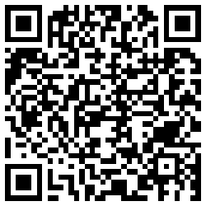
The Presentation

Slide 31
CSC 236
Tutorial 1 - Daniel Razavi

